Slide 1
FLOOD MONITORING AND EARLY WARNING SYSTEM

Slide 2
ABSTRACT
Floods represent a pervasive and devastating natural hazard with far-reaching consequences for both human lives and infrastructure. This abstract explores the critical importance of flood monitoring and early warning systems in reducing the impact of these disasters. Effective flood management relies on the integration of advanced technologies, including remote sensing, meteorological data, and real-time monitoring networks.

Slide 3
INTRODUCTION
Flood monitoring and early warning systems are crucial components of disaster management, designed to mitigate the devastating impacts of floods. These systems involve the continuous surveillance of various environmental factors, such as rainfall, river levels, and weather conditions, to detect potential flood events. When certain thresholds are exceeded or specific patterns are identified, alerts are issued to authorities and communities at risk, enabling them to take proactive measures to protect lives and property. The effectiveness of flood monitoring and early warning systems relies on advanced technology, real-time data analysis, and efficient communication channels to provide timely and accurate information to those in harm’s way, ultimately saving lives and reducing the socio-economic impact of flooding disasters

Slide 4
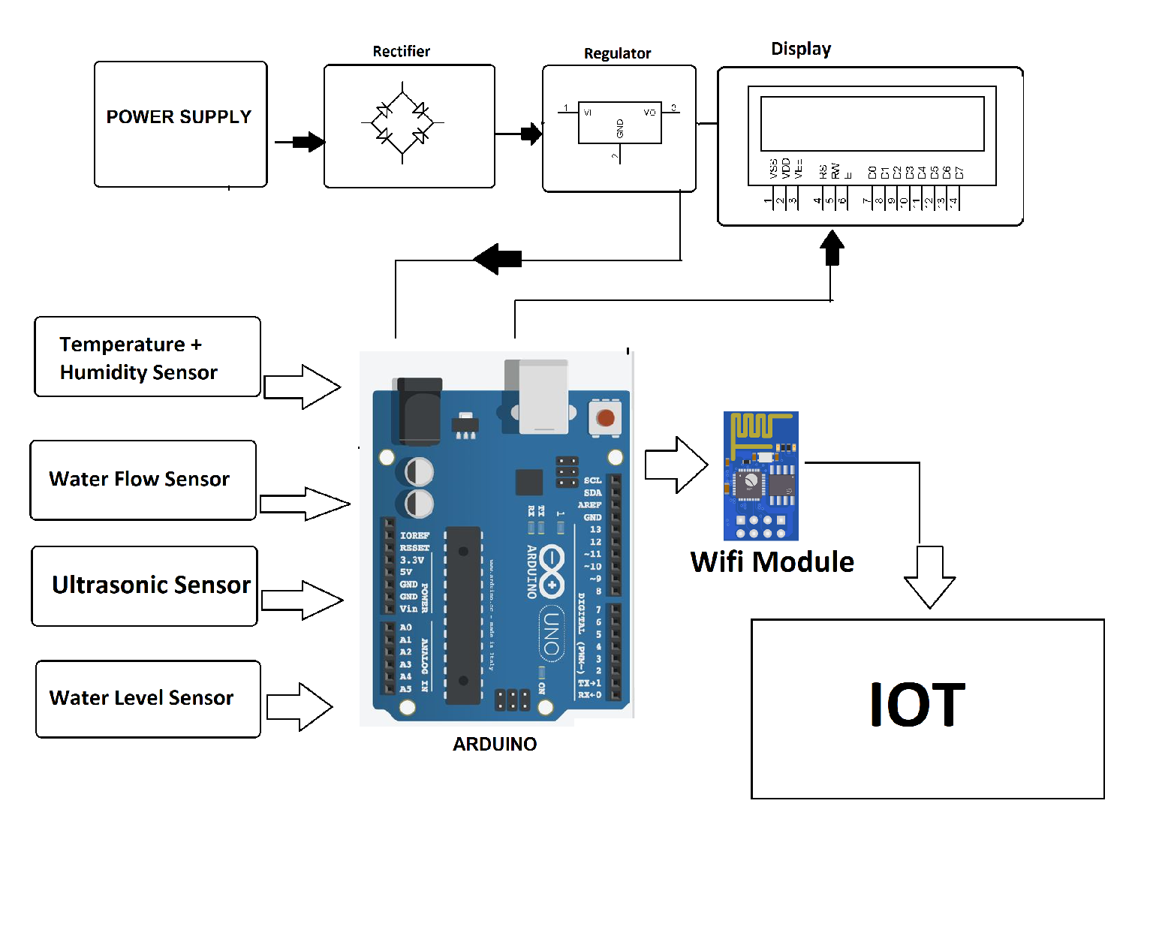
DESIGN

Slide 5
HARDWARE COMPONENTS
. Power Supply
. Node MSU Esp8266
. Ultrasonic Sensor HC-SR04
. 16×2 LED display
. Red LED & Green LED
. LM 35 temp
. GSM SIM 800L
. Arudino UNO
. Water level sensor

Slide 6
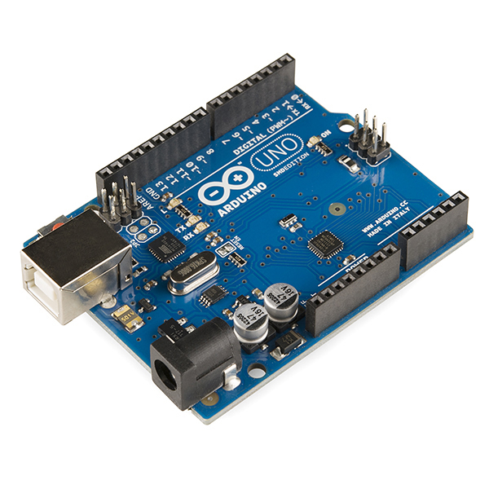
ARDUINO UNO
The Arduino Uno is a popular open-source microcontroller board. It is based on the ATmega328P microcontroller and is designed for easy prototyping and development of electronic projects.
Arduino UNO

Slide 7
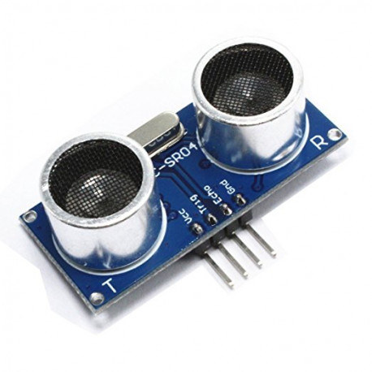
ULTRASONIC SENSOR
An ultrasonic sensor is a device that uses ultrasonic sound waves to detect the distance or presence of objects. It works by emitting high-frequency sound waves (usually beyond the range of human hearing) and then measuring the time it takes for the sound waves to bounce back after hitting an object. By calculating the time it takes for the sound waves to return, the sensor can determine the distance to the object.
Ultrasonic sensor

Slide 8
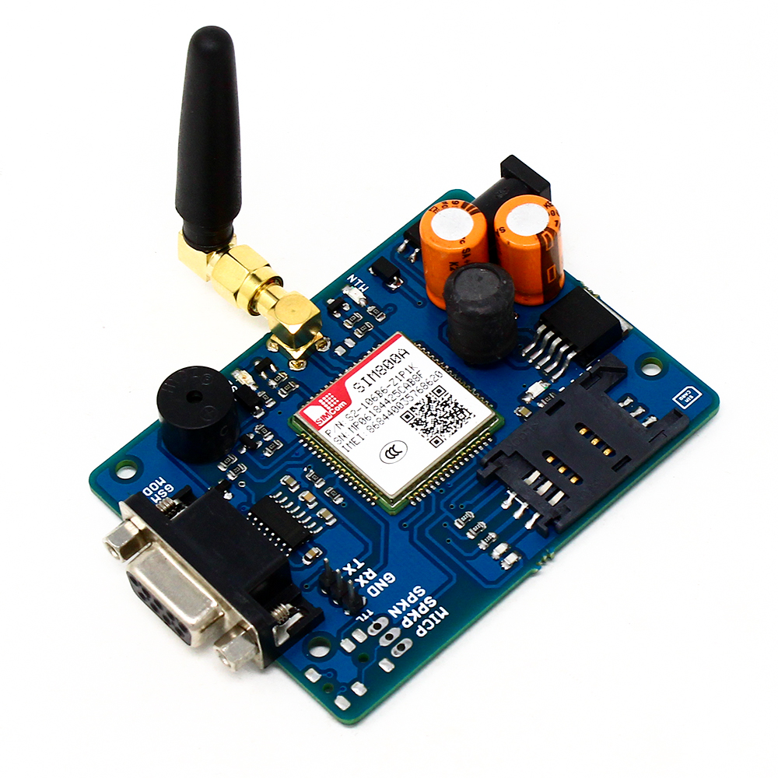
GSM
A GSM (Global System for Mobile Communications) module in IoT (Internet of Things) is a hardware component that allows IoT devices to connect to cellular networks. It enables communication between the IoT device and a remote server or control center through the cellular network, making it possible for the device to send and receive data over long distances. GSM modules are commonly used in IoT applications where Wi-Fi or other wired connections are not feasible or reliable. They can be used for various purposes, such as tracking devices, remote monitoring, and control of equipment, and more.
Gsm

Slide 9
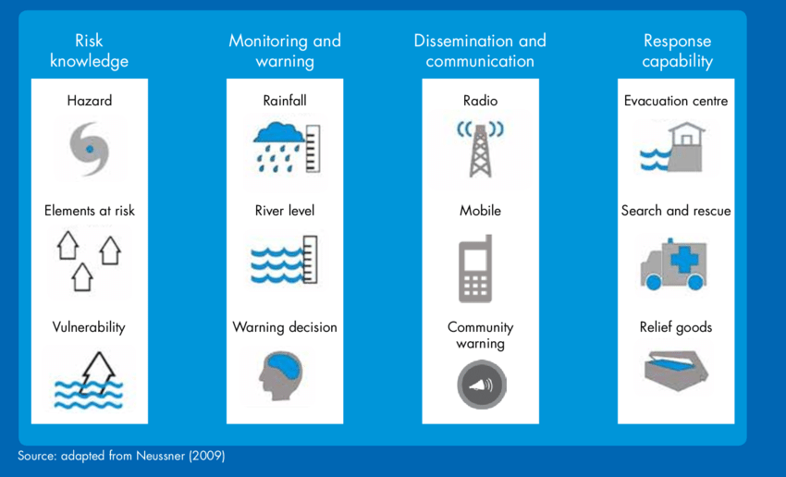
TECHNICAL STACK

Slide 10
CONCLUSION
Flood monitoring is crucial for early warning and disaster management. It involves the use of various technologies like remote sensing, weather forecasts, and river gauges to assess flood risks. Effective flood monitoring can save lives and reduce property damage by providing timely alerts and information to authorities and the public. Continuous advancements in technology and data analysis are improving the accuracy and efficiency of flood monitoring systems, making them increasingly important in the face of climate change and growing urbanization.

Slide 11
THANK YOU

